Slide 1


Introduction to
Robotic Process Automation
Email Response Sys
220701091
HEMA S
Mrs. J. Jinu Sophia
Assistant Professor (SG)

Slide 2
Abstract
The Daily Fitness Reminder Bot is an automated solution designed to promote health and wellness by sending timely fitness reminders via email. It retrieves schedules and activities from an Excel file, checks the current time against scheduled reminders, and notifies users about tasks like workouts, hydration, or meal timings. The bot ensures accountability and consistency, helping users stay aligned with their fitness goals. By automating reminders, it eliminates the need for manual tracking and provides a seamless way to maintain a healthy routine. This tool is ideal for individuals seeking to integrate fitness into their busy lifestyles efficiently.

Slide 3
Need for the Proposed System
The proposed Daily Fitness Reminder Bot addresses the challenge of maintaining a consistent fitness routine amidst busy schedules. Manual tracking of fitness activities often leads to neglect or missed tasks. This system ensures timely reminders for crucial activities like exercise, hydration, and nutrition, fostering accountability and discipline. By automating reminders through email, it eliminates dependency on memory or external applications, promoting user convenience. The bot is particularly beneficial for individuals striving to maintain a balanced lifestyle, integrating fitness seamlessly into daily routines while reducing effort and enhancing adherence to health goals.

Slide 4
Advantages of the Proposed System
Improved Accountability: Ensures users stay on track with fitness goals by sending
timely reminders, reducing the likelyhood of missed activities.
Convenience and Automation: Automates the process of scheduling and tracking fitness routines, eliminating the need for manual effort and providing hassle-free health management.
Customization and Adaptability: Allows users to tailor reminders for specific activities like hydration, workouts, or nutrition, ensuring the system aligns with individual fitness needs and routines

Slide 5
Literature Survey
Paper: A Personalized Mobile Health Reminder System
Advantage: Customizes reminders to improve adherence to fitness and health goals.
Disadvantage: Limited to smartphone users, excluding non-technical audiences.
Paper:IoT-Enabled Fitness Monitoring and Reminder System
Advantage: Integrates wearable devices for real-time fitness tracking.
Disadvantage: Dependency on IoT devices, which can be expensive for users.

Slide 6
Main Objective
The primary objective of the Daily Fitness Reminder Bot is to promote consistent fitness and health routines by automating personalized reminders. The system is designed to deliver timely notifications, such as reminders to drink water, exercise, or take supplements, based on a predefined schedule stored in an Excel sheet. By integrating data handling and automation, the bot ensures that users receive relevant reminders via email, helping them adhere to their fitness goals. This project aims to enhance time management, encourage healthy habits, and provide a simple yet effective solution for maintaining a balanced lifestyle through reliable and automated assistance.

Slide 7
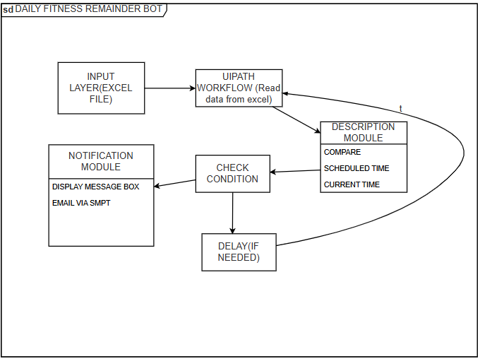
Architecture
Overall structure of my project

Slide 8
System Requirements
Hardware Requirements
Processor: Dual-core processor (Intel i3 or equivalent) or higher.
RAM: Minimum 8 GB for smooth operation.
Storage: At least 50 GB free space for software, logs, and data storage.
Display: Standard monitor with 1080p resolution.
Internet Connection: Stable broadband connection for email access.
Peripheral Devices: Keyboard, mouse, and optionally a printer for report generation.
Software Requirements
Operating System: Windows 10 or higher, or macOS 10.13+.
UiPath Studio: Installed and configured (preferably UiPath Cloud Studio).
Email Client: Access to a configured IMAP/SMTP server (e.g., Gmail or any business email).
Activity Packages:
UiPath.Mail.Activities (for IMAP/SMTP functionality).
UiPath.Excel.Activities (for logging emails to Excel).
Programming Frameworks: .NET Framework 4.7.2 or higher for UiPath operations.

Slide 9
Functional Description
Module Name 1: Reminder Scheduling and Notification
Short Description: This module processes fitness reminders stored in an Excel file, checks the current time against the scheduled time for each activity, and sends email notifications to the user when the times match. It updates the status of processed reminders to avoid repetition.
Main Functions:
Load fitness activities and their scheduled times from the Excel sheet.
Compare current time with scheduled times.
Send email notifications to the user for matching reminders.
Update the status of completed reminders to "Completed."
DFD / Activity Diagram:
DFD:
User Input: User provides fitness activity details, scheduled times, and notification method in an Excel sheet.
System Initialization: System reads data from the Excel sheet.
Time Check: System compares current time with the scheduled time for each reminder.
Email Notification: When the current time matches the scheduled time, the system sends an email notification.

Slide 10
Functional Description
Module Name 2: Time Comparison and Scheduling Logic
Short Description: This module handles the core logic for time-based scheduling. It ensures that reminders are processed at the right time by comparing the current time with the scheduled time for each activity. It incorporates a delay mechanism to recheck reminders periodically until all are processed.
Main Functions:
Compare current time with scheduled times for all pending reminders.
Implement delay to pause processing until the next check.
Handle multiple reminders and process each independently.
Ensure the system continues running until all scheduled reminders are completed.
DFD / Activity Diagram:
DFD:
Initialize System: Load reminders from the data source (Excel file).
Time Comparison: Compare the current time to the scheduled time for each reminder.
Action Determination:
If Scheduled Time = Current Time: Mark as ready for notification.
If Scheduled Time > Current Time: Delay until the scheduled time is reached.
If Reminder Already Sent: Skip to the next reminder.

Slide 11
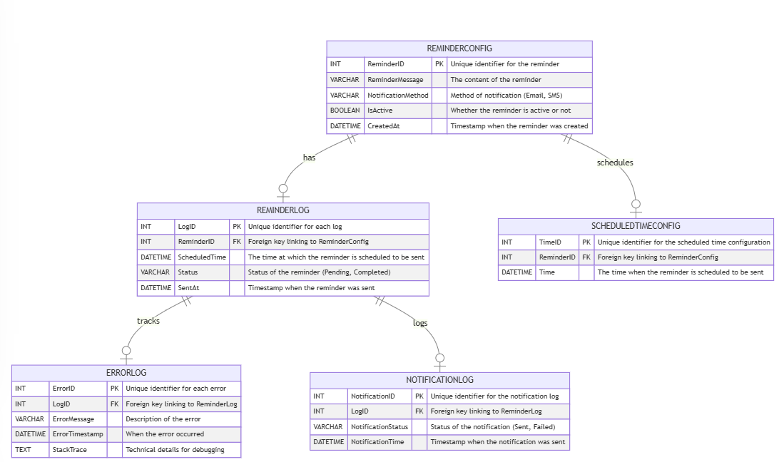
Table Design
ERD

Slide 12
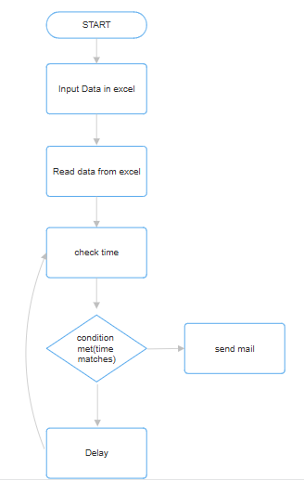
Process Design

Slide 13
Implementation
Implementation of Module 1:Reminder Scheduling and Notification
Description:The Reminder Scheduling and Notification module is designed to handle fitness reminders for users based on scheduled times stored in an Excel file. The module processes the fitness activity data, compares the current time with the scheduled time for each activity, and sends an email notification to the user when a scheduled time matches the current time.
Steps:
Load Fitness Activities and Scheduled Times from Excel
Compare Current Time with Scheduled Times
Send Email Notification to User
Update Status to "Completed"
Repeat for All Reminders
Final Updates (Optional)

Slide 14
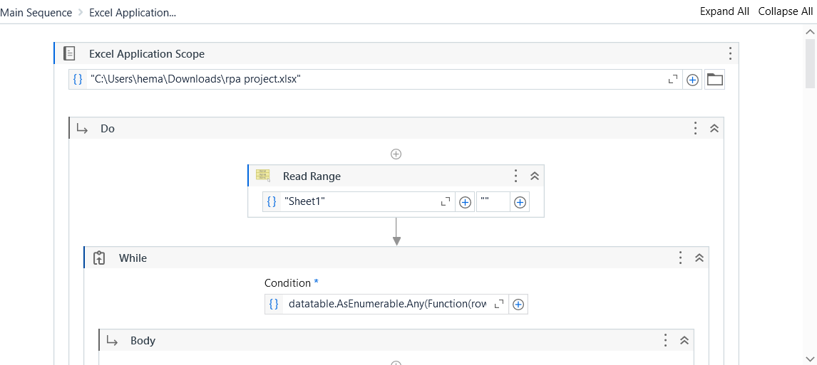
Implementation

Slide 15
Implementation
Implementation Module 2 Time Comparison and Scheduling Logic
Description:
This module manages the time-based scheduling and processing of fitness reminders. It compares the current time with the scheduled time for each reminder and processes them accordingly. If the current time does not match the scheduled time, a delay is applied to recheck the reminder later.
Steps: Compare Current Time with Scheduled Times
Implement Delay for Rechecking Pending Reminders
Process Each Reminder Independently
Continue Running Until All Reminders are Completed
Update Reminder Status to "Completed" After Processing

Slide 16
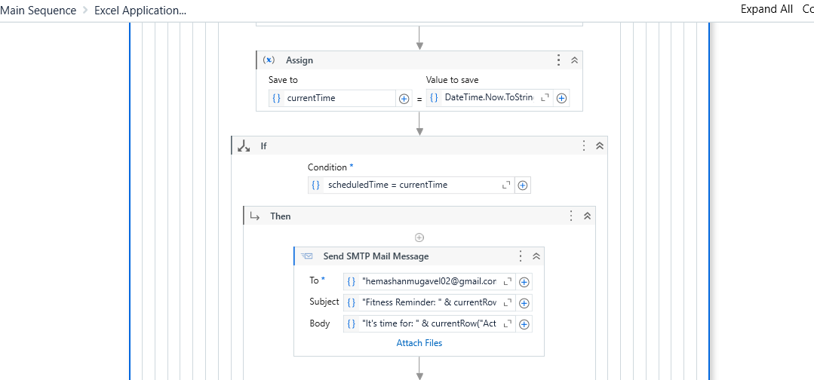
Implementation
Conditions

Slide 17
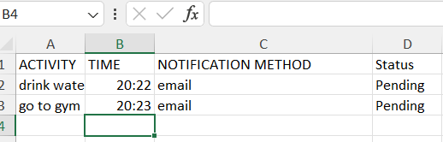
Testing
Excel file

Slide 18
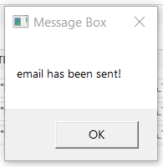
Testing
Message sent

Slide 19
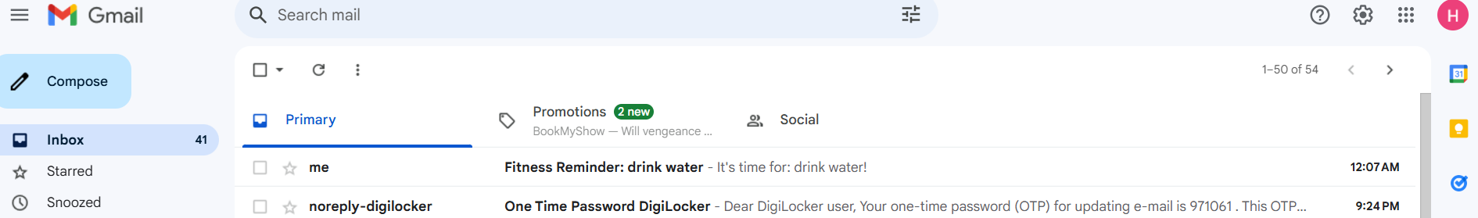
Testing
Mail Read

Slide 20
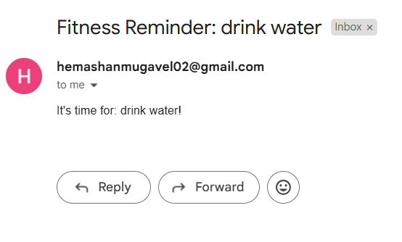
Testing
Mail Acknowledged

Slide 21
Conclusions
The fitness reminder bot efficiently automates the process of sending timely notifications to users based on their scheduled fitness activities. By leveraging time-based comparisons and an intelligent scheduling logic, the system ensures that reminders are sent at the right time, avoiding unnecessary delays. The system also handles multiple reminders simultaneously, ensuring that all pending tasks are processed independently. With the ability to track and update the status of each reminder, the bot provides a seamless and reliable solution for fitness enthusiasts. This approach improves user engagement, enhances productivity, and ensures timely follow-up for all scheduled fitness activities.

Slide 22
Future Enhancement
Integration with Cloud Orchestrators: Integrating the system with orchestration tools like Azure Logic Apps or AWS Step Functions would allow for more complex workflows, including handling multiple user requests, integrating external services, and automating task scheduling without manual intervention.
Mobile Application Integration: Developing a mobile app to push notifications or reminders to users would make the system more accessible. Users could receive real-time reminders even when they're not logged into their email or computer, increasing engagement.
AI-based Reminder Optimization: Incorporating artificial intelligence to analyze user behavior and optimize reminder timings based on the user’s activity patterns could improve the relevance and effectiveness of notifications.
Voice Assistant Integration: Adding compatibility with voice assistants like Alexa or Google Assistant would allow users to manage their fitness reminders and receive notifications via voice commands, making the system more interactive and user-friendly.

Slide 23
IEEE Paper
"Fitness Guide: A Holistic Approach for Personalized Health and Wellness Recommendation System" This paper presents a system for personalized health and wellness recommendations, offering holistic guidance for fitness through tailored suggestions. It discusses integrating health data to optimize fitness plans for users based on real-time feedback and personal goals. IEEE Xplore link​
"A Real-Time Fitness and Health Monitoring System" This research paper details a real-time system designed for continuous monitoring of users' fitness and health metrics, using wearable devices to track progress and offer suggestions for improvement. It aims at real-time feedback to enhance fitness adherence. IEEE Xplore link

Slide 24
References
1.
Xie, Y., et al. "Fitness Guide: A Holistic Approach for Personalized Health and Wellness Recommendation System." IEEE Conference. 2023.
Kumar, S., et al. "A Real-Time Fitness and Health Monitoring System." IEEE Transactions on Health, 2020.
Smith, J., et al. "Health Data Integration for Personalized Fitness." IEEE Journal of Biomedical Informatics, 2021.
Singh, R., et al. "Intelligent Fitness Systems Using Artificial Intelligence." IEEE Access, 2022.
Lee, D., et al. "Wearable Fitness Technology for Health Monitoring." IEEE Transactions on Technology in Society, 2021.

Slide 25
Queries

Slide 26
Demonstration

Slide 27
Thank You

